Slide 1




Plant Monitoring System
Cristian Baba
Inês Carvalho

Slide 2
OUR GOAL
An internet based data logging framework that provides data collected by a set of sensor units at the manufacturing plant of Cartonagem Trindade.

Slide 3
PROBLEM
Cartonagem Trindade have large open spaces an high ceilings and every operator is free to open any window at the working place
The company works with high temperatures and it is important to keep in track with environmental changes. Because it can have effects on the final product

Slide 4
What does the client want?
The client wants to control and have information about the environmental, such as Temperature, Pressure and Humidity in the production area of the plant in order to create scenarios for controlling the ventilation or the inflating of hot air with the use of the burners.

Slide 5
SOLUTION
Development of a distributed acquisition system made up of autonomous processing units. The units of collection of Temperature, Humidity and Pressure;
The data are collected in a central unit that makes them available in a computer(website) that allows the monitoring in Real Time of the evolution of the monitors monitored;

Slide 6
Client Requirements
Build of the sensors of humidity, temperature and pressure
Gathering data from the sensors
Sending the data to a database
Building of the website
Dashboard with graphics with specific data
Fabril plant color map of each sensor data

Slide 7
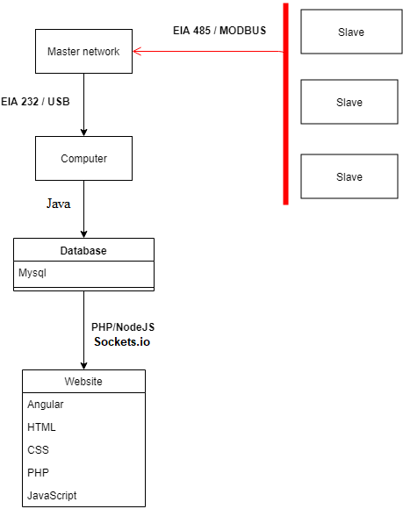
Project architecture and sensors(master/slaves)

Slide 8

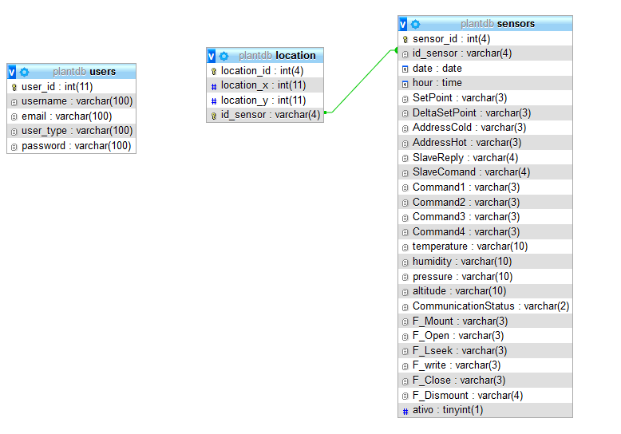
Data Base Architecture

Slide 9




Slide 10
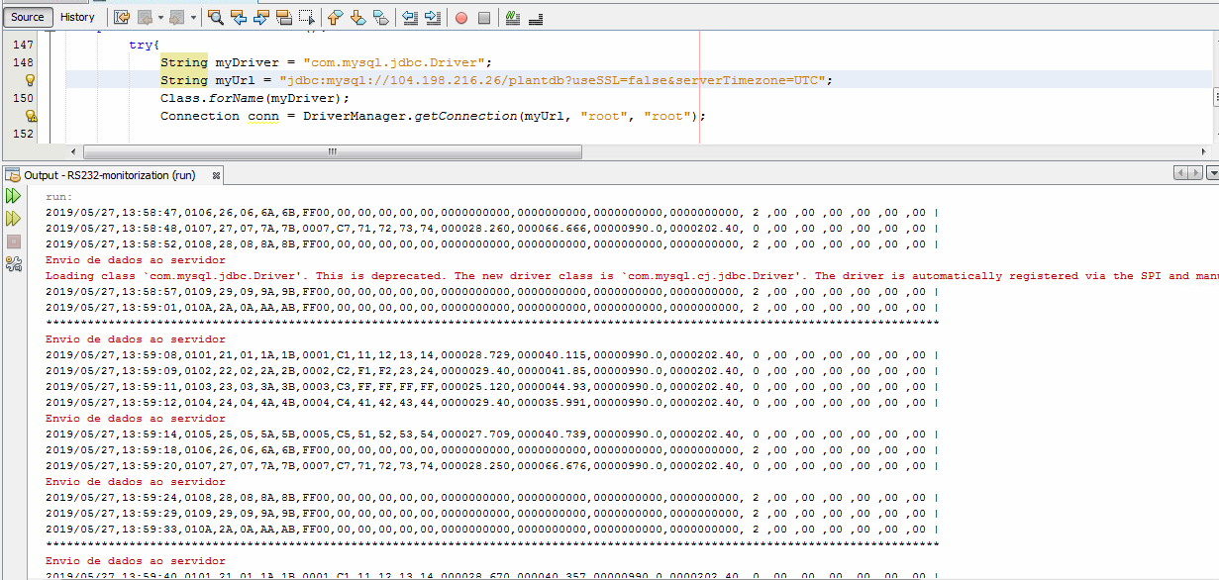
Java RS232 Monitorization System

Slide 11





Backend
Website
Frontend

Slide 12
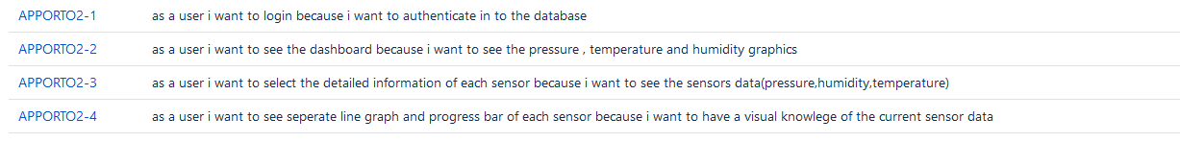
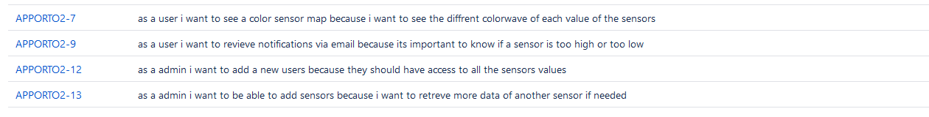
SPRINTS
Sprint 1
Sprint 2
Sprint 3

Slide 13

Now we’ll show the actual project

Slide 14


Dificulties

Slide 15
Thank You!
Any Questions?

